Slide 1

Notes:
1st slide (Mandatory)

Slide 2
Unit and Tens digit positions

Slide 3
Face & Place Values of the Digits in a Number
Numbers are named in terms of the place value system with base 10, in which the value of a digit depends on the place in which it is located in the numeral. The rightmost digit represents the unit's or one's place. Its place value is calculated by multiplying its face value (i.e., the digit itself) with 1.
The second digit from the right represents the ten's place. Its place value is calculated by multiplying its face value with 10. The third digit from the right represents the hundred's place, and so on.

Slide 4
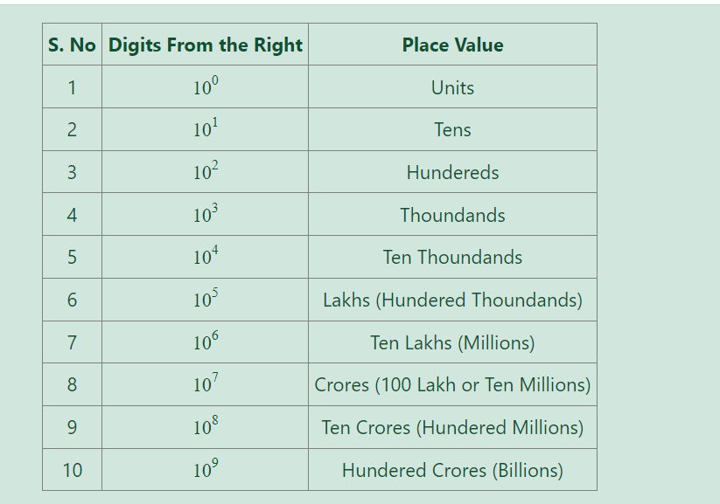
The following table will be uesful for translating any number in numberical from to word form.

Slide 5
TYPE 1,2,3
Type 1:
Last digit--->0,1,5,6
Eg: 110^71 = 0(unit digit) , 311^82 = 1(unit digit)
Type 2:
Last digit--->4(odd,even) = 4,6 / 9(odd,even) = 9,1

Slide 6
Type 3
Remainders | 1 | 2 | 3 | 0
2 | 2 | 4 | 8 | 6
3 | 3 | 9 | 7 | 1
7 | 7 | 9 | 3 | 1
8 | 8 | 4 | 2 | 6
Power/4

Slide 7
QUESTION 1
The unit digit in 3 × 38 × 537 × 1256 is
8
3
4
5
Notes:
ANS:A

Slide 8
QUESTION 2
The units digit of the expression 25^6251+36^528+73^54 is
0
3
4
2
Notes:
ANS: A
EXPLANATION
5+6+9 = 20

Slide 9
QUESTION 3
The sum of two digit number and the number obtained by interchanging the digits is 110. if 10 is suntracted from the first number, the number is 4 more than 5 times the sum of the digits in the first number. Find the first number.
18
64
36
17
Notes:
ANS:B
Sum of two digit = x+y
Let the tens digit of the required number be x and the units digit be y. Then,
x+y=110 .........(1)
Required Number = (10x+y).
Number obtained on reversing the digits = (10y+x).
Therefore,(
10(y+x) + (10x+y) = 110
11x+11y = 110
11(x+y)=110
x+y=110/11
x+y=10-----1
10x+y-10 = 5(x+y)+4
10x+y-10 = 5*10+4
10x+y = 64
eval eq1 and 2
10x+y = 64
x+y = 10
--------------
9x=54 ----->x=6
number = 10x+y
10(6) + y
60 + 4
64

Slide 10
QUESTION 4
In a two–digit number, the digit at the unit’s place is more than twice the digit at the ten’s place by 1. If the digits at unit’s and ten’s place are interchanged, the difference between the new and the original number is less than the original number by 1. The original number is
37
12
10
81
Notes:
ANS:1
Two digit number = x+y
let the digit at ten’s place be x
unit place = 2x+1
original number = 10x+y-->10x+(2x+1)
new number = 10y+x--->10(2x+1)+x
diff = [10(2x+1)+x] - [10x+(2x+1)] = 10x+(2x+1) - 1
20x+10x+x-10x-2x-1 = 10x+2x+1-1
9x+9 = 12x
9 = 3x
x=3
ten’s place be x = 3
unit place =2x+1 = 7
original number = 10x+(2x+1) = 30+7=37

Slide 11
QUESTION 5
One’s digit of the number (22)^23 is
1
9
8
2
Notes:
ANS:C

Slide 12
QUESTION 6
The unit digit of 2^3^4 * 3^4^5 * 4^5^6 * 5^6^7 * 6^7^8 * 7^8^9 is:
0
5
can’t be determined
none of these
Notes:
ANS: A
2^12 * 3^20 * 4^30 * 5^42 * 6^56 * 7^72
2^4 *3^4 * 4^2 *5^40*5^2*6^56*7*4
6*1*6*5*5*6*1
UNIT DIGIT = 0

Slide 13
QUESTION 6
Find the unit place digit in 71*72*73*74*76*77*78*79
2
6
4
0
Notes:
ANS:B
(1*2*3*4) * (6*7) * (8*9)
24*42*72
4*2*2=16
6

Slide 14
QUESTION 7
The digit in unit’s place of the product 81*82*83*....*89 is?
0
2
6
8
Notes:
ANS: A
1*2*3*4*5*6*7*8*9
5*2 = 10 (UNIT DIGIT 0 IS MULTIPLIED WITH ALL THE NUMBERS SO THE ANSWER WILL BE 0.

Slide 15
QUESTION 8
Find the last non-zero digit of n! , n=103
3
4
5
7
Notes:
ANS:B
2^A * A! * B!
103/5 = Q=20---A , R = 3----B
2*20 * 20! * 3!
6 * [2^4 * 4! * 0!] * 6
6*4*6
4

Slide 16
QUESTION 9
If the unit digit of 433*456*43N is (N+2), then what is the value of N?
A. 1
B. 8
C. 3
D. 6
Notes:
ANS: D
3*6*N = (N+2)
8 * N = N+2
ANS=8*6 = 6+2
8 = 8

Slide 17
QUESTION 10
The digit in the unit place of the number 7^295 X 3^158 is
A. 7
B. 2
C. 6
D. 4
Notes:
ANS: A
If the power as more than 3 digits divide the last two digit of the power with 4
95/4=3(remainder) , 7^3 = 343 (last digit is 3)
58/4=2(remainder) , 3^2 = 9
so, 3*9=27 (last digit is 7)
Ans=7

Slide 18
EXERCISE
1. What is the digit in the unit place of (24)^63 + (33)^61 - (27)^58?
2. If 4^3x+5=16,then find the value of x.
3. What is the unit digit of 593^23 * 124^26?
4. The digit in the unit’s place of the number represented by(7^95 - 3^58) is:
5. The digit in the unit position of the integer 1!+2!+3!+....+99! is
6. What is the unit digit of 217^413 *819^547 * 414^624 * 342^812?
7. The rightmost non-zero digit of the number 30^2928?
8. In how many ways can eight people line up from left to right for a group photo?
9. The right most non-zero digit of 80^1365?
10. What is the rightmost non-zero digit of number 770^3430?
Notes:
1.unit digit will be 4+3-9 = -2
10-2=8
2. 4^3x+5 = 4^2
3x+5 = 2
3x = 5-2
3x=-3
x=-1
3. 7*6=2
4. 3-9=-6 then 10-6=4(ans)
5. 1!=1
2!=2
3!=6
4!=4
5!=0
6!=0
for the remaining numbers unit digit will be 0
1+2+6+4+0+0+0=13
7. (3*10)^2928
3^2928 * 10^2928
3^4=81 answer is 1
8. 40,320 ways.
9. (80)^1365
(8*10)^1365
8^1365 * 10^1365
According to type 3 power should be divide with 4
As per the last two digit of the power 65/4 = 1(remainder)
So, 8^1=8
10. 770^3430
77^3430 *10^3430
According to type 3 power should be divide with 4
As per the last two digit of the power 30/4 = 2(remainder)
So, 7^2=49 , ans is 9

Slide 19
THANK YOU

